Slide 1
Creational Patterns (2)
CS350/SE310 Fall 2015

Slide 2
Economic Goal
Lower the Cost of Maintenance
Design Principles (SOLID)
Coupling-Cohesion, Open-Close, Information-Hiding, Dependency Inversion, Separation of Concerns…
Experiences of leveraging OO to follow the principles
Design Patterns
OO programming
Inheritance, Encapsulation, Polymorphism
Notes:
Show the simple maze code

Slide 3
Original Maze Game
public Maze createMaze (MazeFactory factory) { Maze aMaze = new Maze (); Room r1 = new Room (1); Room r2 = new Room (2); Door theDoor = new Door(r1, r2);
aMaze.addRoom(r1); aMaze.addRoom(r2);
r1.setSide(Direction.NORTH, new Wall ()); r1.setSide(Direction..EAST, theDoor); r1.setSide(Direction..SOUTH, new Wall()); r1.setSide(Direction..WEST, new Wall()); r2.setSide(Direction..NORTH, new Wall()); r2.setSide(Direction..EAST, new Wall()); r2.setSide(Direction..SOUTH, new Wall ()); r2.setSide(Direction..WEST, theDoor); return aMaze;
}

Slide 4
Factory Method Pattern

Slide 5
Factory Method Pattern
public Maze createMaze (MazeFactory factory) { Maze aMaze = makeMaze(); Room r1 = makeRoom(1); Room r2 = makeRoom(2); Door theDoor = makeDoor(r1, r2);
aMaze.addRoom(r1); aMaze.addRoom(r2);
r1.setSide(Direction..NORTH, makeWall()); r1.setSide(Direction..EAST, theDoor); r1.setSide(Direction..SOUTH, makeWall()); r1.setSide(Direction..WEST, makeWall()); r2.setSide(Direction.NORTH, makeWall()); r2.setSide(Direction..EAST, makeWall()); r2.setSide(Direction..SOUTH, makeWall()); r2.setSide(Direction..WEST, theDoor); return aMaze;
}

Slide 6
Abstract Factory Pattern

Slide 7
Abstract Factory Pattern
public Maze createMaze (MazeFactory factory) { Maze aMaze = factory.makeMaze(); Room r1 = factory.makeRoom(1); Room r2 = factory.makeRoom(2); Door theDoor = factory.makeDoor(r1, r2);
aMaze.addRoom(r1); aMaze.addRoom(r2);
r1.setSide(Direction..NORTH, factory.makeWall()); r1.setSide(Direction..EAST, theDoor); r1.setSide(Direction..SOUTH, factory.makeWall()); r1.setSide(Direction..WEST, factory.makeWall()); r2.setSide(Direction..NORTH, factory.makeWall()); r2.setSide(Direction..EAST, factory.makeWall()); r2.setSide(Direction..SOUTH, factory.makeWall()); r2.setSide(Direction..WEST, theDoor); return aMaze;
}

Slide 8
What if Maze Components can be mixed
For Factory Method Pattern
Too many subclasses
For Abstract Factory Pattern
Too many concrete factories
What we can do?
Introducing prototype pattern

Slide 9
Prototype Pattern

Slide 10


Creation vs. cloning
Creation is hard work
We are better at cloning
vs.

Slide 11
Creation vs. cloning
When you instantiate an object with the new operator you create it out of thin air:
e.g. in Java , the JVM goes through a complex process of loading, memory allocation, initialization …
Cloning an existing object may be a better choice
Especially when the object is complex and/or large

Slide 12
Prototype pattern
A prototype is an object that packs in advance all the necessary info for further instances
Instead of instantiating new instances, clients clone the prototype
Notice that cloning carries over the full state of the prototype

Slide 13
Real world usage
Examples:
Object contains data that is complex to compute
Object contains lots of data
Object contains data that are loaded from a slow medium
You want to give the same data to multiple workers

Slide 14
Prototype - structure

Slide 15
Implementing Prototype Pattern
Shallow vs. Deep
Who refer to which?
Different languages do it differently

Slide 16
Prototype in Java
Option 1: Implements Cloneable
Overrides
public Object clone() {…}
Option 2: Use serialization
Ensure that all classes in the object's graph are serializable.
Create input and output streams.
Use the input and output streams to create object input and object output streams.
Pass the object that you want to copy to the object output stream.
Read the new object from the object input stream and cast it back to the class of the object you sent.
See examples

Slide 17
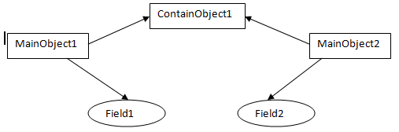
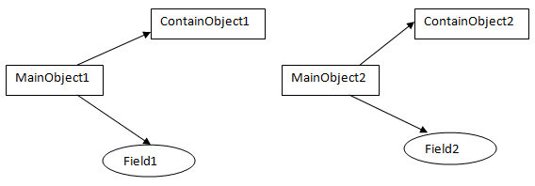
Shallow Copy vs. deep Copy
Shallow Copy
Deep Copy

Slide 18
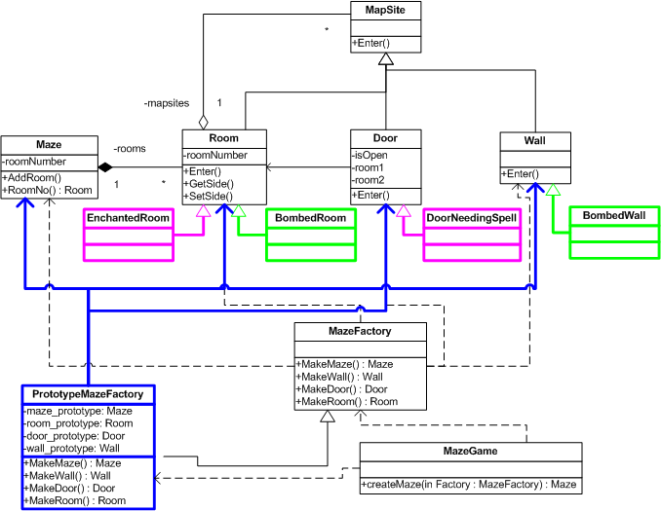
Prototype MazeGame

Slide 19
The Maintenance of Simple Maze Game
Is not Simple!
Which and how many classes will be
Add?
Removed?
Changed?

Slide 20
What are the concerns?
Features/Concerns
Maze Components: wall, door, room maze ---Factory Patterns (FM and AF)
red, blue, enchanted, bombed, HarryPotter, SnowWhite…
Each type requires a *family* of components
Maze Structure: ---Determined by the client
2 rooms? 9 rooms? 100 rooms? Square maze?
Component Building:
How many walls a room can have? 4? 8?
How to build a room? E..g. follow the order of N, S, E.W?
Maze Building Process:--Suppose to be stable
1. Maze, 2, Rooms, 3, Doors
…

Slide 21
Simplification
We would like to factor out the knowledge about how to assemble Rooms.
Solution?
Hire a contractor
A “Builder”
And just give orders:
Act as the “Director” of the work

Slide 22
Meet the Builder

Slide 23
Builder Pattern - structure

Slide 24
Builder Participants
Builder
specifies an abstract interface for creating parts of a Product object
ConcreteBuilder
constructs and assembles parts of the product by implementing the Builder interface
defines and keeps track of the representation it creates
provides an interface for retrieving the product
Director
demands the construction of an object using the Builder interface
Product
represents the complex object under construction. Concrete builder builds the product’s internal representation and defines the process by which it is assembled

Slide 25
Builder: motivation
The algorithm for creating a complex object should be independent of the parts that make up the object and how they’re assembled
The construction process must allow different representations for the object that’s constructed

Slide 26
The Maze with Builder
Simplify the code of the CreateMaze method by passing it a MazeBuilder as a parameter.
MazeBuilder interface can be used to build three things
1) the maze
2) rooms with a particular room number
3) doors between numbered rooms.

Slide 27
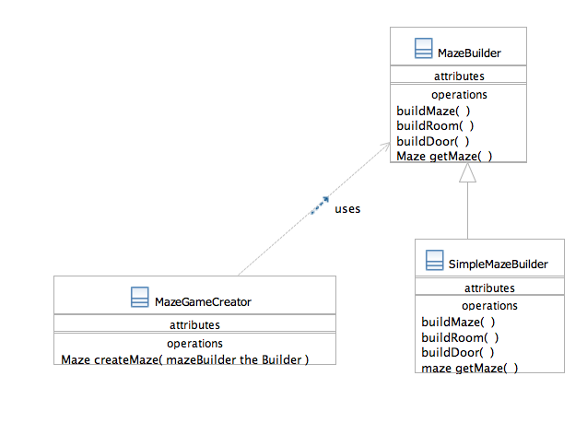
The Maze - Builder
abstract

Slide 28
The Maze ---Builder
The operations in the abstract MazeBuilder super-class are meant to be overridden by subclasses, i.e. concrete builders.
Concrete builders will override also GetMaze() to return the Maze they build

Slide 29
Modified code
In the MazeGameCreator class:
Maze createMaze(Builder theBuilder) {
builder.buildMaze()
builder.buildRoom(1);
builder.buildRoom(2);
builder.buildDoor(1,2);
return builder.getMaze()
}
public Maze createMaze (MazeFactory factory) { Maze aMaze = factory.makeMaze(); Room r1 = factory.makeRoom(1); Room r2 = factory.makeRoom(2); Door theDoor = factory.makeDoor(r1, r2);
aMaze.addRoom(r1); aMaze.addRoom(r2);
r1.setSide(Direction.NORTH, factory.makeWall()); r1.setSide(Direction.EAST, theDoor); r1.setSide(Direction.SOUTH, factory.makeWall()); r1.setSide(Direction.WEST, factory.makeWall()); r2.setSide(Direction.NORTH, factory.makWall()); r2.setSide(Direction.EAST, factory.makeWall()); r2.setSide(Direction.SOUTH, factory.makeWall()); r2.setSide(Direction.WEST, theDoor); return aMaze;
}

Slide 30
The Maze ---Builder
Notice how the Builder hides
the internal representation – that is classes that define rooms, doors and walls – of the maze
how these parts are assembled to form the final maze.
This makes easy to change the way Maze is represented since no client code is dependent on it.
For instance we might have windows in the representation of rooms
This is a design decision that is hidden from clients.
Client only needs to know about Maze, Rooms and Doors
in very little detail

Slide 31
The Maze ---Builder
Subdividing responsibility between the Maze and Builder classes and separating the two
Enabled reusability of part of the construction process
Can have a variety of MazeBuilders each constructing mazes with different classes for rooms, walls, doors.
What was the basis for the decision which part of the construction remains in the MazeCreator, and what is delegated to Builder?
Find what must vary and extract it, hide it.
The varying parts: type of walls, doors, rooms varies,
The stable parts: e.g. the fact that rooms are connected by doors.
Notes:
Show the simple maze builder code. What do we do if we need different types of maze too?

Slide 32
Do we still need A Factory?

Slide 33
The Maze ---Builder
The concrete builder SimpleMazeBuilder is an implementation that builds simple mazes.
Let’s take a look at its code:
public interface MazeBuilder {
void makeMaze();
void addDoor(int room1, int room2, Direction d, boolean open);
void buildRoom(int roomnum);
Maze getMaze();
}
public class SimpleMazeBuilder implements MazeBuilderMazeBuiilder
Maze myMaze;
Maze getMaze() { return myMaze; }
void buildMaze() { myMaze = new Maze(); }
void buildRoom (int i) {
r = new Room(i):
// all room-construction code …
myMaze.addRoom(r);
}

Slide 34
SimpleMazeBuilder
This simple builder takes care of object instantiation itself
With vanilla rooms etc.
We could still use a Factory
For extensibility
For separation of concerns
Let’s create a FactoryMazeBuilder

Slide 35
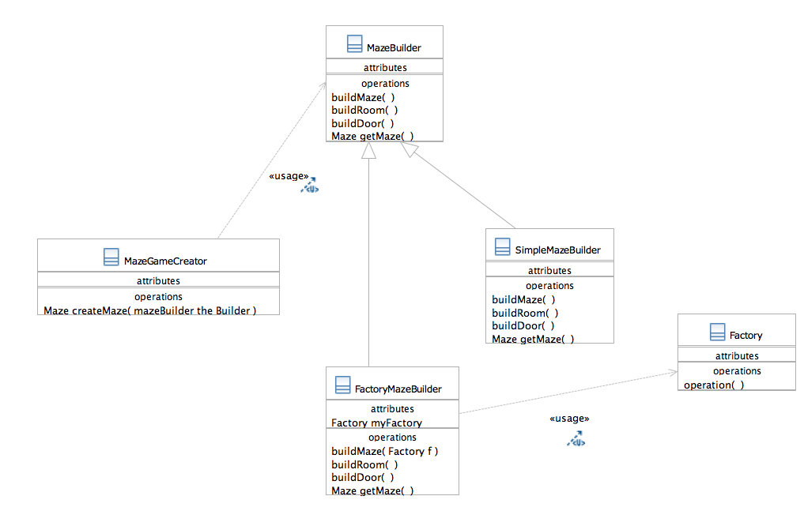
FactoryMazeBuilder

Slide 36
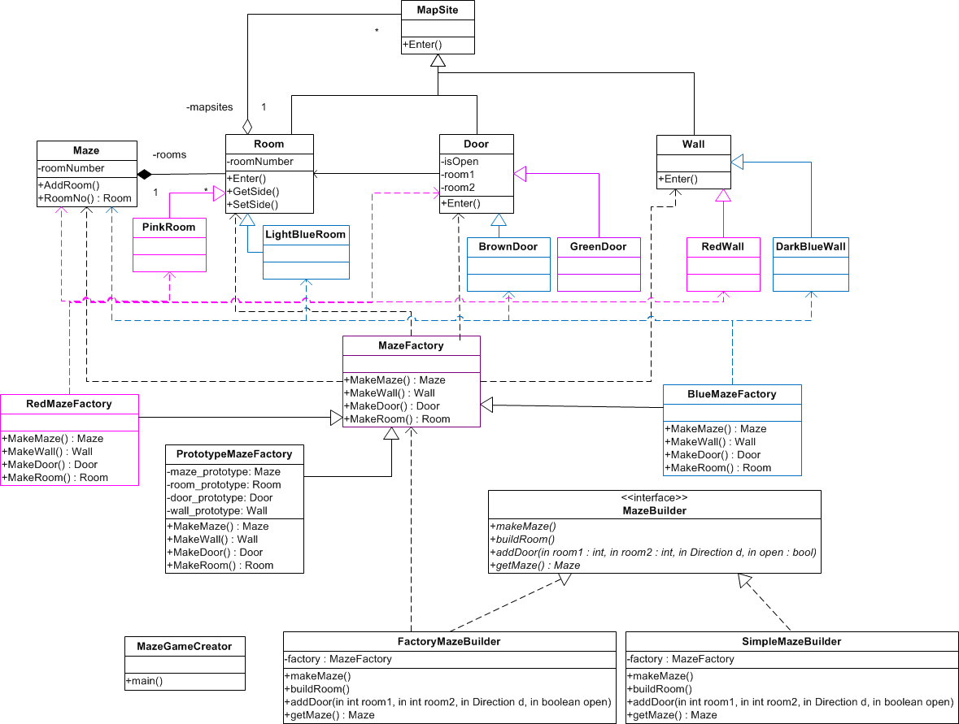
Builder Maze Game

Slide 37
One of a Kind Objects
There are cases in which you need one object of a certain type
One and only one
Shared globally across the system
Examples:
Abstraction for accessing a single resource (e.g. log file)
A load balancer object
A centralized Factory
A dialog box that is used across the GUI

Slide 38
Requirements
Enforce uniqueness:
make sure nobody can create further instances
use information hiding mechanisms
Responsibility:
you don’t want the clients of that object to be responsible for checking uniqueness and for usage policy
encapsulate that responsibility within the class of that object

Slide 39
The Singleton pattern

Slide 40
A bullet-proof Java “idiom”
public class Singleton {
// Private constructor suppresses generation of (public) default constructor
private Singleton() {}
/**
* SingletonHolder is loaded on the 1st call of Singleton.getInstance()
* or the first access to SingletonHolder.INSTANCE, not before.
*/
private static class SingletonHolder {
private final static Singleton INSTANCE = new Singleton();
}
public static Singleton getInstance() {
return SingletonHolder.INSTANCE;
}
}

Slide 41

The Singleton Pattern ensures a class has only one instance, and provides a global point of access to it.
Singleton
instance is a private class attribute
instance() is a class (static) operation.
Creates and maintains its own unique instance.

Slide 42
The Singleton pattern
Classification:
Creational purpose; Object scope
Context: You want to have only one object of a class, but no global object controls the instantiation of this object. You want to ensure all clients reference this object without passing a handle to all of them
Problem: several clients need regulated access to the same thing, and you want to ensure uniqueness
Solution: guarantees one and only on instance
Consequences:
Clients do not need to care about existence or uniqueness of singleton instance
They do not need to pass around references

Slide 43
Creational patterns
Creational patterns involve object instantiation and all provide a way to decouple a client from objects it needs to instantiate
Members of this “group”:
Factory Method
Abstract Factory
Builder
Prototype
Singleton

Slide 44
We have done with all Creational Patterns

Slide 45
(SOLID) Design Principles
Single Responsibility (Separation of Concern, Low coupling, High cohesion)
Open Close Principle
Liskov Substitution Principle
Let q(x) be a property provable about objects x of type T. Then q(y) should be provable for objects y of type S where S is a subtype of T.
Interface Segregation Principle
Dependency Inversion Principle (Information Hiding, Favor composition over inheritance)

Slide 46
Code Smells
Code Clone
Feature Envy
God Method/Class

